Slide 1

Miles ES
Mays Cluster
Thalise Perry

Slide 2
9 years
4
9 years
1
IB
In progress
August 2023
Teaching and Learning Professional Learning and Curriculum Development
26 students
502(without P)
63 students
581(without P)
14 students
79

Slide 3
Indicator | Time Frame
 | September 2021 | September 2022
Attendance Take Rate | 100% | 100%
ADA Attendance Rate | 87.7% | 90.1%
Students not chronically absent | 57% | 72.7%
0.04
Subgroup | Total number of students | OSS Suspension Rate
Female | 231 | 0
Male | 275 | 0.05
SWD | 45 | 0
Black | 467 | 0.03
Hispanic | 30 | 0
Multi-race | N/A | N/A
White | N/A | N/A
Asian | N/A | N/A
*As of 10/02/2022
*As of 9/28/2022
Notes:
ACES 2.0 School culture
Restorative practices
Family engagement

Slide 4
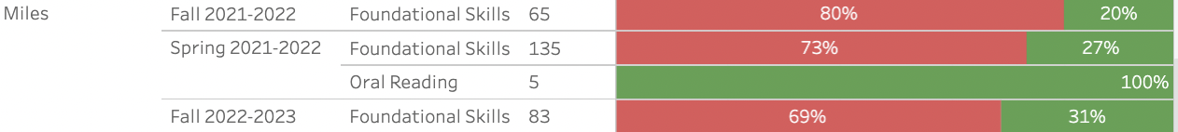

Slide 5
Program | Avg. Daily Use (Mins) |  | Avg. Weekly Use (Days)
 | Spring 2022* | Fall 2022** | Spring 2022 | Fall 2022
System 44 | 16.9 minutes | 17.3 minutes | 1.9 days | 2.4 days
iRead | 24.9 minutes | 24.0 minutes | 1.9 days | 1.6 days
*Spring 2022: As of April 30, 2022
**Fall 2022: As of September 16th, 2022

Slide 6
 | CIP Strategy | Action Step Progress Update
ELA | Miles ES will show 5-10% growth in ELA on the MAP assessment. We will increase the number of students moving from one performance domain to the next by 10 students in ELA on GMAS. | -Implement a consistent framework and expectation for using ReadyGen Updates: -All K-5 teachers has been District trained or refreshed on the ReadyGen resource. -District and school-based observations are done on a regular basis with immediate teacher feedback. -Students engage in 45 minutes of reading intervention daily (System 44 and iRead) K-3 STudents have designated Fundations Block that is monitored daily
Math | Miles ES will show 5-10% growth in Math on the MAP assessment. We will increase the number of students moving from one performance domain to the next by 10 students in Math on GMAS. | -Implement a consistent framework and expectation for using Eureka Math Updates: -All K-5 teachers received school-based Eureka training during PLCs. -Ongoing training will be conducted during faculty meetings to enhance strategies and the use of Eureka-suggested manipulatives.
Whole Child & Student Support | Miles ES will implement a Whole-Child system of supports that integrates social-emotional learning, behavior, wellness, and comprehensive academic intervention plans.​ | -Implement the House System using the IB learner profiles Updates: -The House System using the IB learner profiles is fully functional and meets bi-weekly in grade-band groups. -A House of the Month is chosen monthly with incentives for students. -SEL is taught daily with emphasis is placed on the IB attributes and students receive House points. 45 min intervention block to address skill deficits.
Family Engagement | Miles ES will improve parental involvement by having 10 additional parents attend each scheduled parent engagement event. | -Contact parents through social media to advertise events. Updates: -Class-dojo is set up and used school-wide to announce all school happenings and communicate with parents. -The Miles Morning Announcements are broadcast via Facebook and all stakeholders are encouraged to tune in. -Twitter is used to share school events and highlight teaching and learning. APTT Meetings to allow parents to review students performance and create goal. Parent nights for our subgroups.

Slide 8
*Strengthen teacher skillset/strategies when teaching Fundations
What support do you need to accomplish your SY23 goals?
Further Fundations Training
Ongoing support for ReadyGen
Guided Reading Training
Support with differentiated instruction

Slide 10
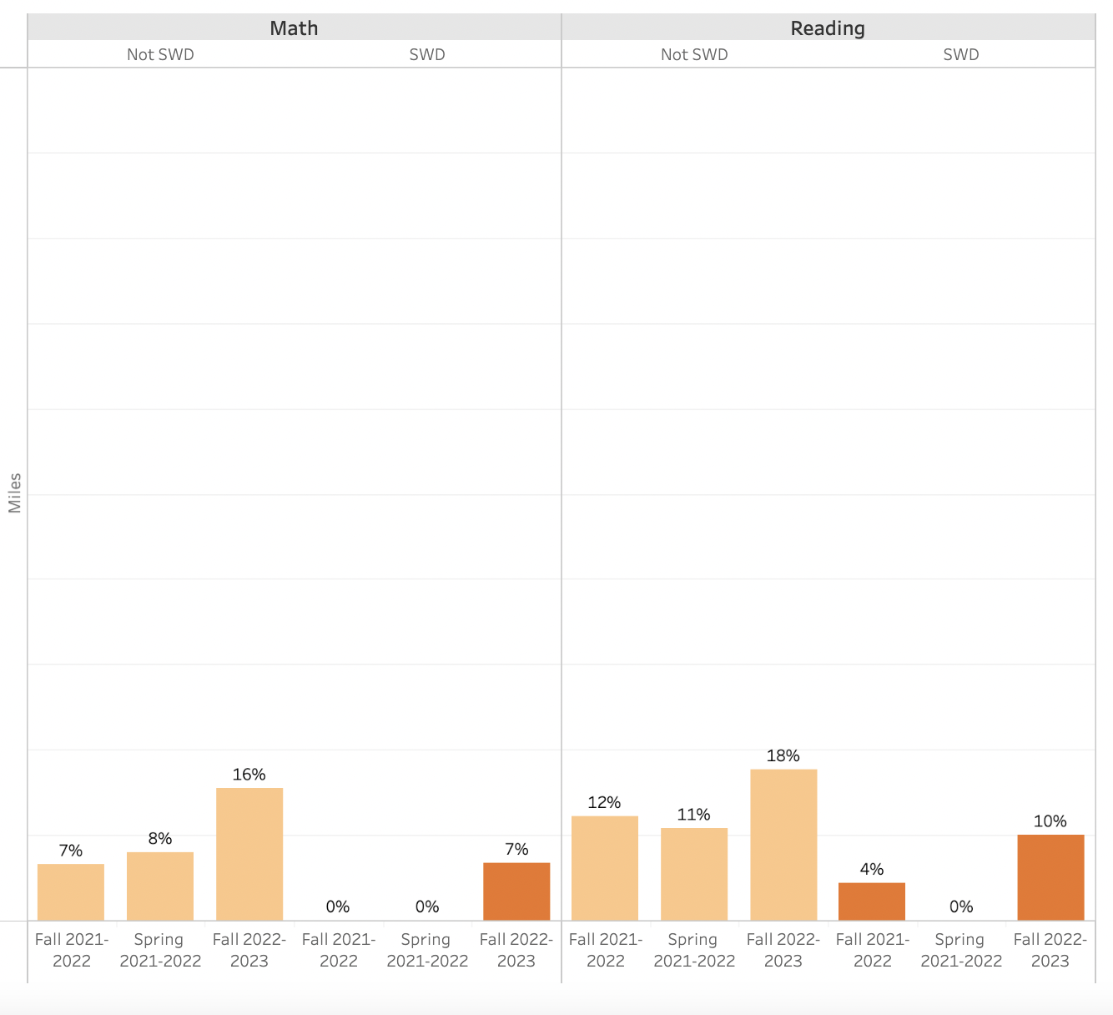

Slide 11
